Slide 1

A Classification Model for Predicting Liver Patients
end
EDA
matrices
process
findings
intro
BY NAIF ALZAHRANI

Slide 2
The Idea
Liver is responsible for up to 500 separate vital functions.
Fighting infections
Transforming food into energy
Dispose of waste
Risk from a range of factors
Poor diet
Alcohol
Genetic factors
Liver damage
Cirrhosis
Hepatitis
Cancer
Early diagnosis of hepatitis offers wider treatment options
end
process
EDA
matrices
findings
intro

Slide 3



Features
Target
Preparation
1
2
3
end
1. Age
2. Gender
3. Total Bilirubin
4. Direct Bilirubin
5. Alkaline Phosphatase
6. Alanine Aminotransferase
7. Aspartate Aminotransferase
8. Total Proteins
9. Albumin
10. Albumin and Globulin Ratio
Result
Cleaning
EDA
matrices
process
findings
intro
(1) Liver Patient
(2) non-Liver Patient.
Fixing Columns
Dropping Nulls
Data Scaling
Pandas Profile

Slide 4
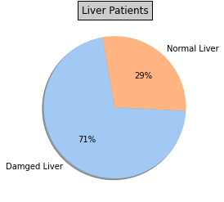
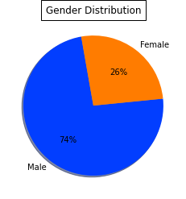
end
EDA
matrices
process
findings
intro
Balance
Records
Gender
30691 Rows
21917 LD
8774 None

Slide 5
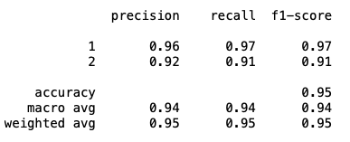
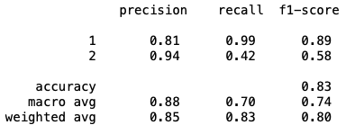
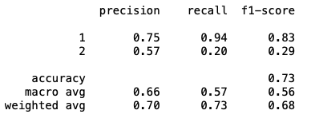
01
03
Random Forest
k-nearest neighbors
The maximum score is 0.97 at K = 1
Scored 0.83 at depth 5
end
process
EDA
matrices
02
findings
intro
Logistic Regression
Scored 0.73

Slide 6
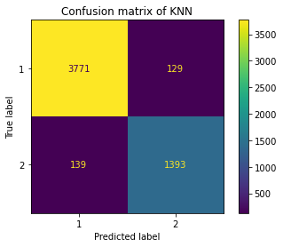
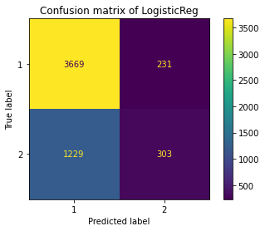
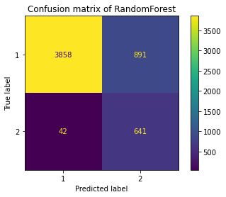
end
matrices
EDA
process
findings
intro

Slide 7
Conclusion:
KNN
Implementation of such model and Early diagnosis.
end
EDA
matrices
process
findings
intro
Thoughts:
Articulate the problem early.
Check your data quality.
Understand the data.
Prepare your data.
Apply your ML algrithms.

